Slide 1


Development of A calibrated leakage measurement device for ocular tonometry
Jonathan Cox
21st Annual Arizona Space Grant Consortium Symposium
April 21, 2012

Slide 2
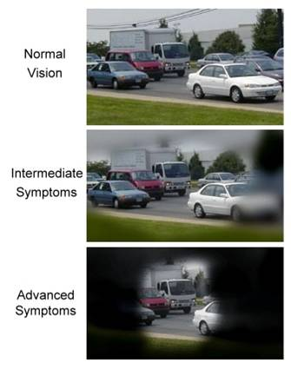
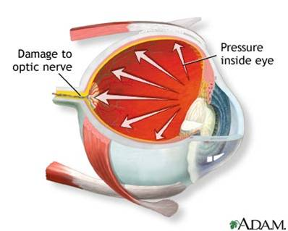
Motivation
Glaucoma is a disease that leads to damage of the nerve that carries visual information to the brain
Elevated intraocular pressure is a significant risk factor for developing glaucoma

Slide 3
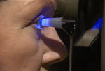
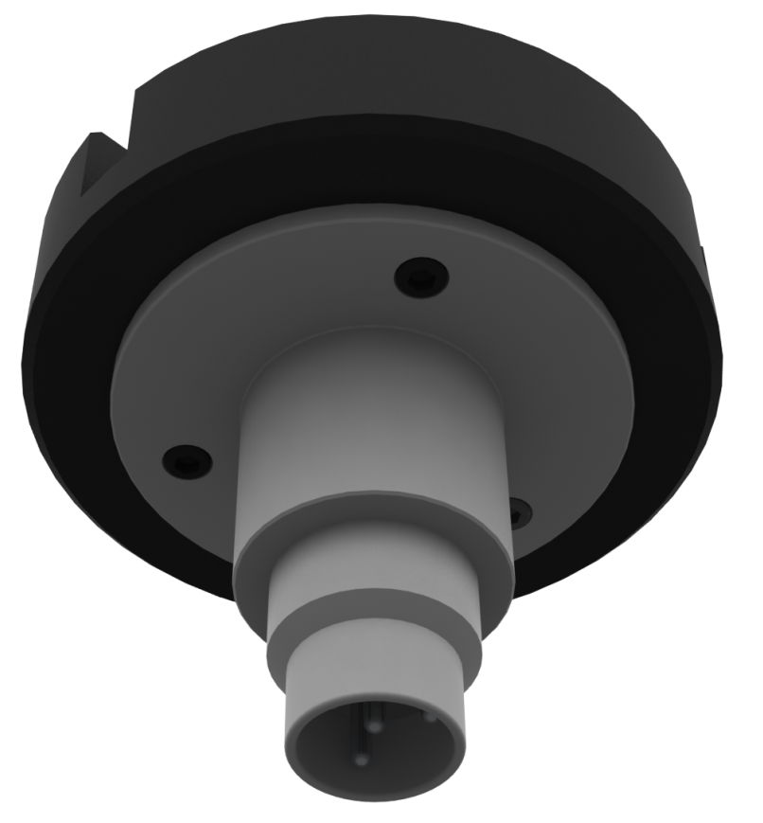
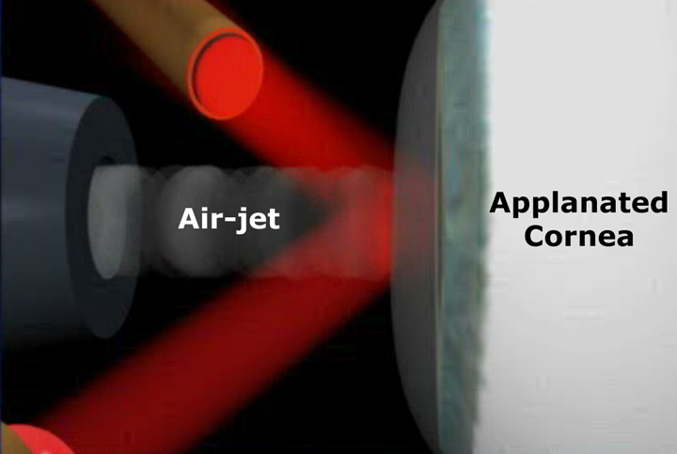
Tonometry
Goldmann Applanation Tonometry
Novel Tonometer Concept
Air Puff Tonometry

Slide 4
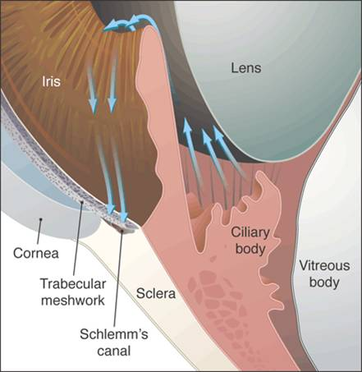
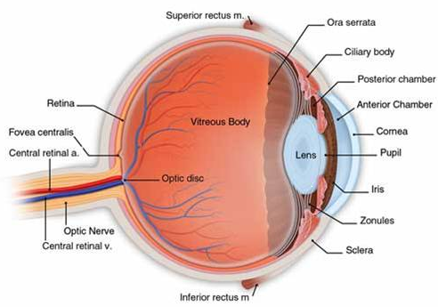
Anatomy of the eye
Aqueous humor is housed in the anterior chamber
Maintains intraocular pressure
Aqueous humor exits anterior chamber at a rate of 2-3 μL/min

Slide 5
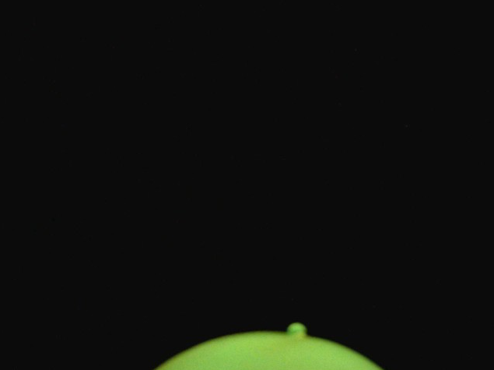
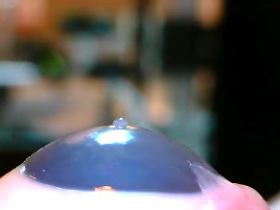

Measuring Outflow with fluorescence
Fluorescence
Droplet forming on eye
MATLAB Interpretation

Slide 6
Methodology
i = imread(‘***.jpg');
g = rgb2gray(i);
gadjust = imadjust(g);
c = roicolor(gadjust,0,100);
cNC = bwareaopen(c,1000)
cNC = ~cNC;%reverse
cfinal = bwareaopen(cNC,1000);
imshow(cfinal);
se = strel('disk',3,8);
bwc = imclose(cfinal,se);
bwfinal = imopen(bwc,se);
L = bwlabel(cfinal);
stats = regionprops(L,'Area');
Area = [stats.Area];
Area = Area/1000;
Volume = .0297*Area^2+.177*Area-.0402
Courtesy of X. Chen
Volume Calibration Curve

Slide 7


Experimental Results
Droplet Volume v. Time
Flow Rate v. Time
$$Q=\frac{dV}{dt}= a_{0}+a_{1}a_{2}e^{−a_{2}t}$$
V $=a_{0}t+a_{1}(1−e^{−a_{2}t})$

Slide 8
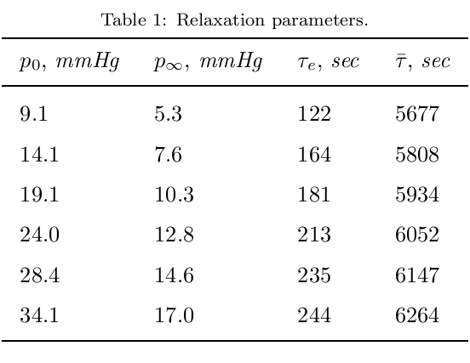
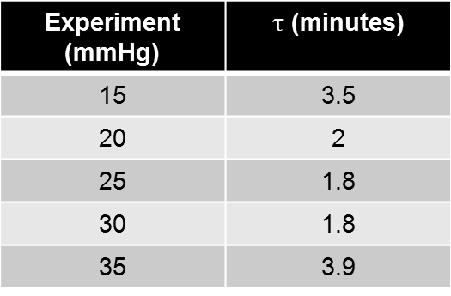

interpretation
Experiment (mmHg) | $τ$ (minutes)
15 | 3.5
20 | 2
25 | 1.8
30 | 1.8
35 | 3.9
τ, the time constant, is a parameter that describes the transient response of a system
$Q=\frac{dV}{dt}= a_{0}+a_{1}a_{2}e^{−a_{2}t}$
$Q=Q_{∞}+{(Q}_{0}−Q_{∞}) e^{−\frac{t}{τ}}$
$τ=\frac{1}{a_{2}}$
Polyvas et al., 2012

Slide 9
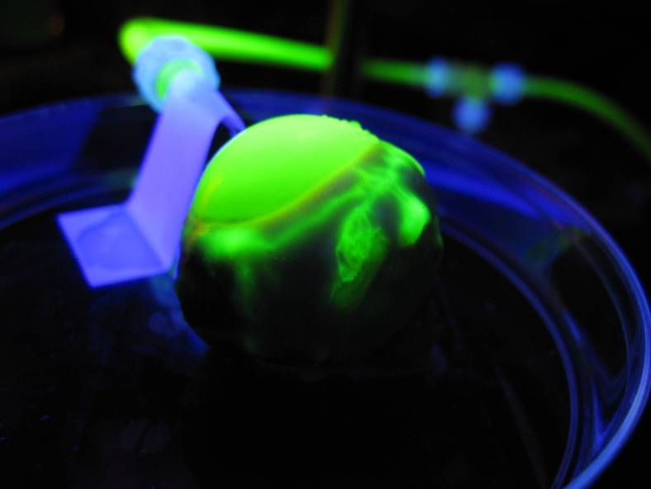
Conclusions
Leakage, while important to maintenance of intraocular pressure, is not a significant factor when taking pressure measurements
The primary pressure relaxation mechanism of the eye is the viscoelastic behavior of the corneo-scleral shell

Slide 10

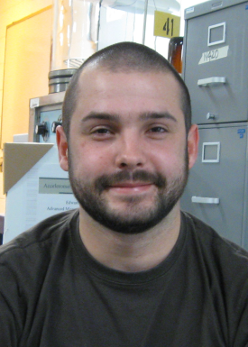
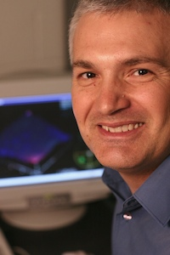
Acknowledgements
NASA Arizona Space Grant Consortium
Mentor
  Dr. Eniko Enikov
Students
  Peter Polyvas
  Marcel Madarasz
  Xiao Chen

Slide 11
Thank you for your attention

